Slide 1
GAAAN
Generative Album Art Adversarial Network
By Patrick Caldwell, Josh Matthews, and Michael McDermott

Slide 2
GAN Album Generator
Project Summary
•The purpose of GAAAN was to offer a tool for musicians and artists to have unique album artwork generated quickly at no cost. The tool is a website with a backend running on flask and a Deep Convolutional Generative Adversarial Network using tensorflow-keras. To train the GAAAN, we curated our own dataset using the Spotify API and some custom functions to grab about 54,000 images for training.

Slide 3
Team
Patrick Caldwell
-Configuration of Flask server and deployment to Google App Engine and GCP
Joshua Matthews
-Training GAN and tuning hyperparameters
Michael McDermott
-Data sourcing & cleaning, GAN modeling and training

Slide 4
Our Deliverables
Link to web service: https://sunlit-mix-274903.wl.r.appspot.com
Repo (URL): https://bitbucket.org/Goku_Sonic/gan/src/master/

Slide 5
Machine Learning Aspects
Data
Originally, we were going to use the one million album artwork dataset available on the internet, but it was very large to download and we felt it was too generic, so we compiled our own dataset of 54,000 using python and the Spotify API.
In the GAN, all the data from the dataset is used for training the discriminator.
After the images were sourced, they had to be resized to size 128x128 pixels, and some sub-datasets were created to try training more specific versions of the GAN (eg, specifically on electronic dance music or specifically metal and rock genres).
The image data had to be normalized from values of 0-255 to -1 & 1
The dataset was about 20GB if saved and loaded in a pkl file, which used a lot of memory when training, so we ended up dynamically loading the data in batches.

Slide 6
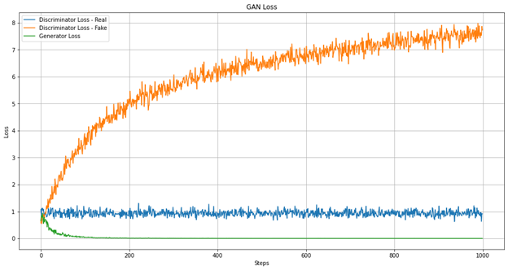
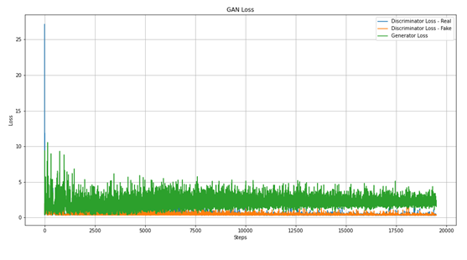
Machine Learning Aspects
Model
The model was mainly measured on loss and our own interpretation of whether we thought the output could pass as an album art image or not. The accuracy and loss metrics were mainly helpful if the generator or discriminator rapidly approached zero or mode collapsed. From our research, we have seen that the loss can fluctuate and even if the generator or discriminator have a loss between .5 – 5 the output could still be good or bad. Metrics really just helped us keep an eye on the training to alert us if there were any drastic changes made. Otherwise, every 50 or so epochs we would have the output printed to screen to see what it looked like and judged our model based off of that.
Graph of first version loss
Loss Graph after architecture revision

Slide 7
Machine Learning Aspects
Model
Our model is a deep convolutional generative adversarial network. We chose this architecture due to it being more stable than other GAN’s. We considered using StyleGAN, but the custom libraries and setup would have taken more time which would have given us less time to experiment. The architecture consists of a generator model and discriminator model. Both have convolutional layers and batch normalization layers. The discriminator model is trained on both the dataset of sourced images, and the output of the generator. Each epoch, the discriminator is updated on whether it was good at detecting a real vs generated image, and the generator is updated on whether it was able to trick the discriminator or not.

Slide 8
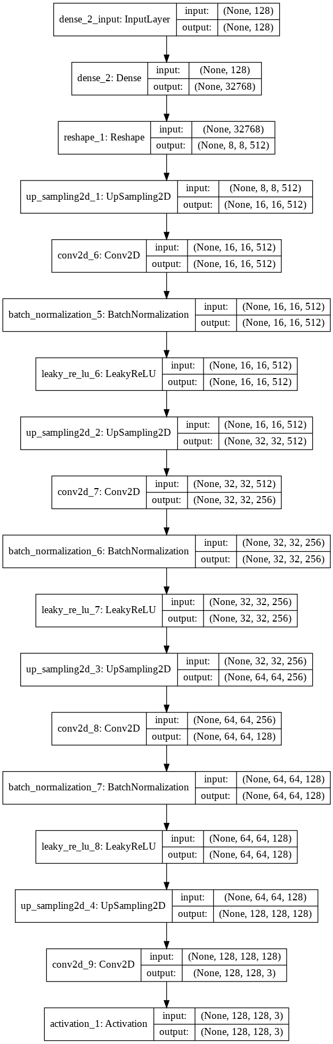
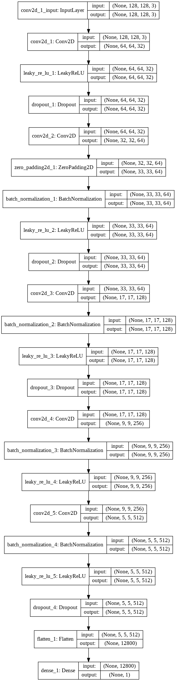
Machine Learning Aspects
Discriminator
Generator

Slide 9
Machine Learning Aspects
Training
o We experimented with multiple epoch lengths and sizes of training data.
o Epoch lengths of 5,000, 10,000, 50,000, 75,000, and 100,000 were used.
o Training data sizes consisted of 54,000 images for a version that was trained on the whole dataset, 8,000 images for the subset of electronic and psychedelic images, and about 5,000 images for the metal/alt rock subset.
o The main hyperparameters that we tuned were the learning rate for the discriminator and generator, number of epochs, noise vector size, strides and kernel size in the convolutional layers, and momentum in batch normalization layers. The current versions have a learning rate of .0015 for the discriminator and learning rate of .0015 for the generator. The batch normalization momentum is currently 0.8.

Slide 10
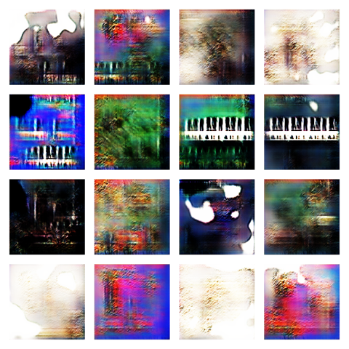
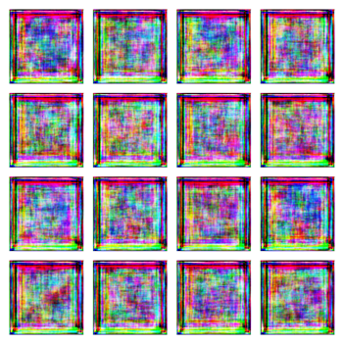
Machine Learning Aspects
Training
Output of first version trained on full dataset Output of second version trained on full dataset at 12,000 epochs

Slide 11
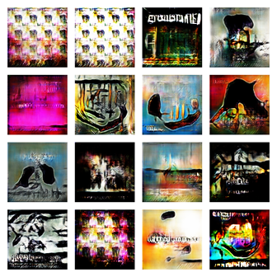
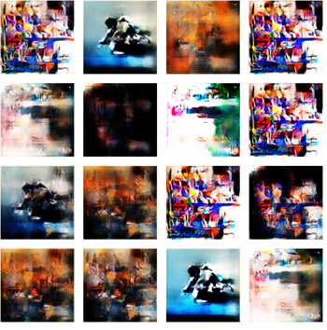
Machine Learning Aspects
Training
Output of final version of electronic genre
Output of final version of rock genre GAN trained only on rock/metal genres (34,000 epochs)

Slide 12
Machine Learning Aspects
Training Results
EDM training: https://imgur.com/XGrmRR1
Metal training: https://imgur.com/ZyyivO7

Slide 13
Machine Learning Aspects
Inference
• Our model's “prediction” is the output of an image, given a random noise vector that is generated by the server when it is called.

Slide 14
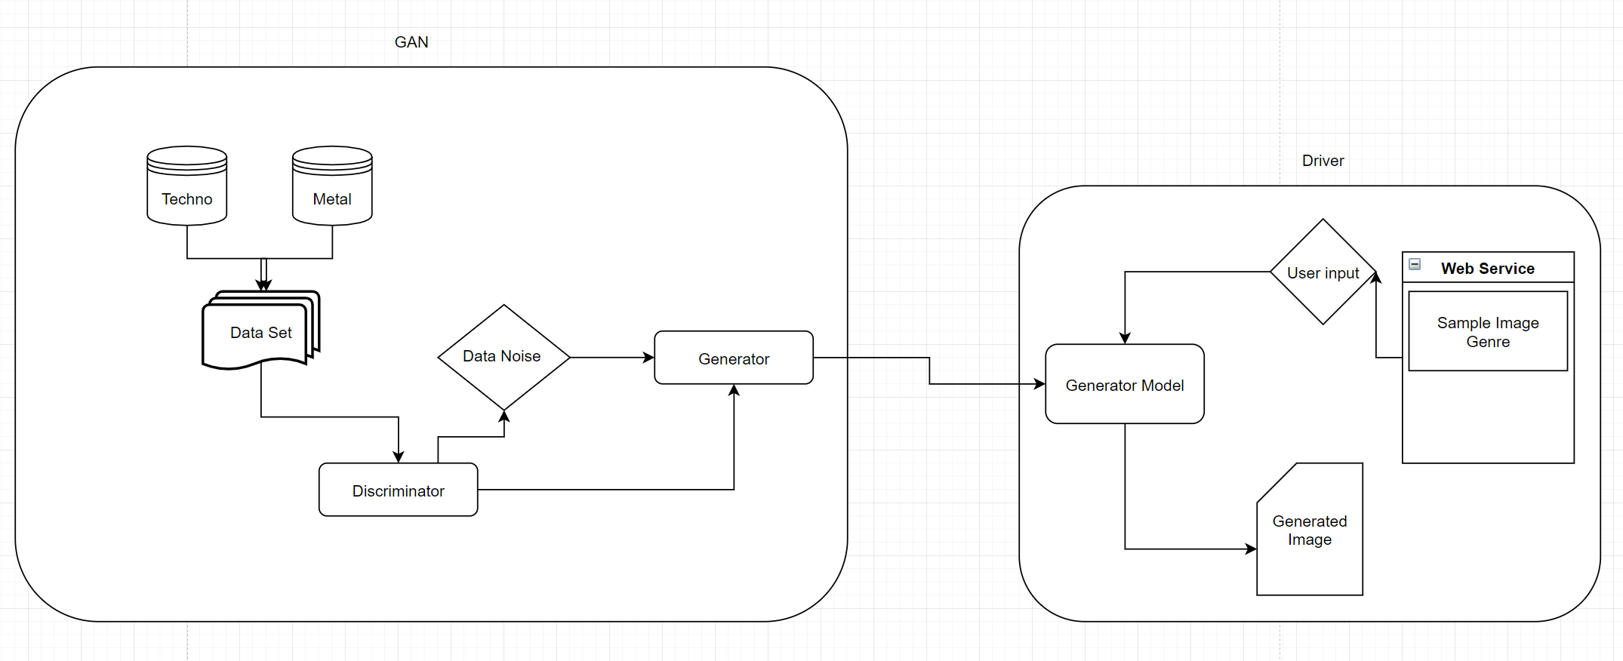
Software
Architecture
• The project is delivered as a web service with an already trained model
• We took multiple data sets and trained images using different noise figures in order to get a result that was usable on the web service.

Slide 15
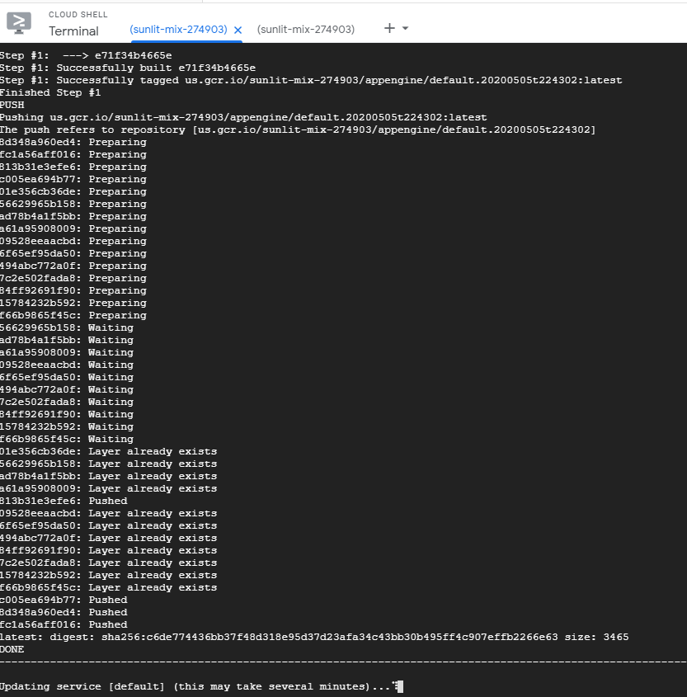
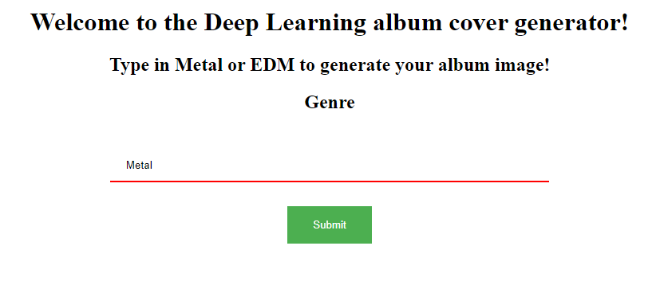
Software
User interface
Is a static html page with a flask wrapper which uses GET and POST functionality in order to utilize the driver code.
https://sunlit-mix-274903.wl.r.appspot.com/

Slide 16
Usage
Use Cases
• Metal Use case
o The driver will recognize that Metal has been chosen
o The Metal model with a noise batch size of 32 and noise of 100 will be loaded within the driver
• EDM use case
o The driver will recognize that EDM has been chosen
o The EDM model with a noise batch size of 32 and noise of 100 will be loaded within the driver
• Default use case
o The driver will recognize that Metal has been chosen
o The General model with a noise batch size of 32 and noise of 128 will be loaded within the driver

Slide 17
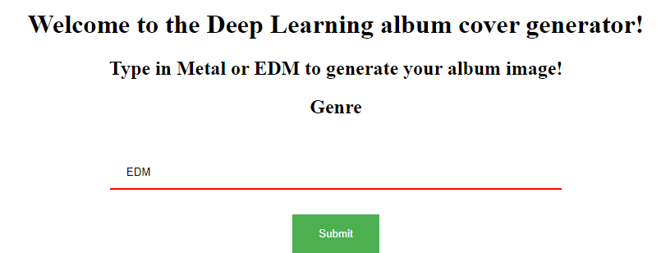
Tests/Demo
Intro Screen

Slide 18
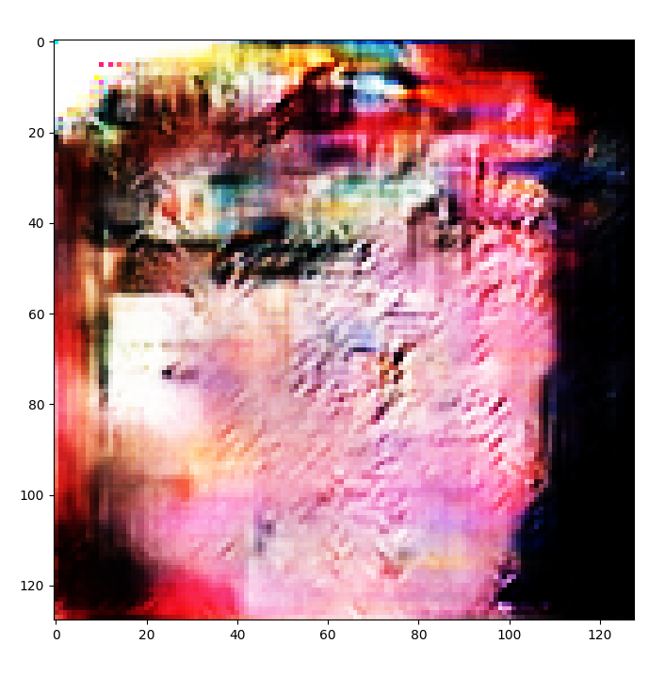
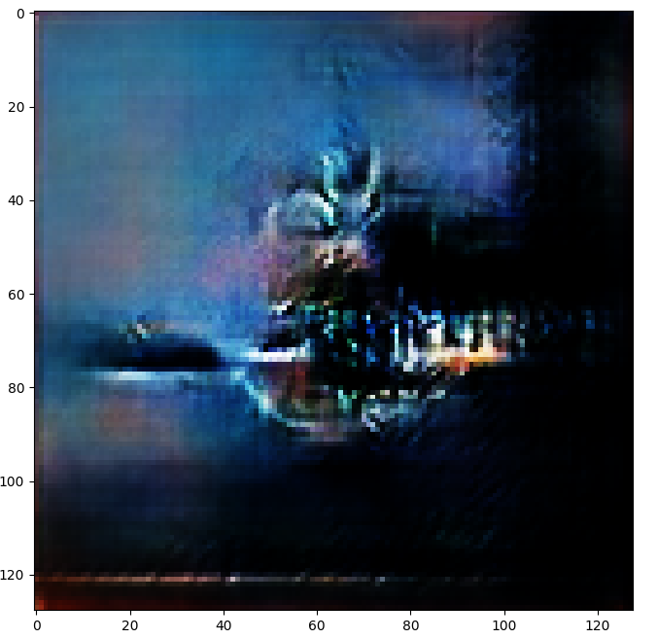
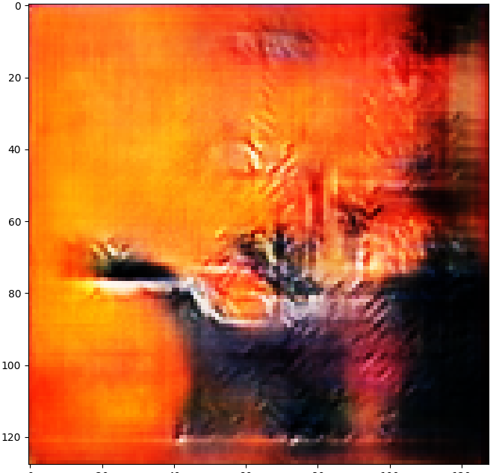
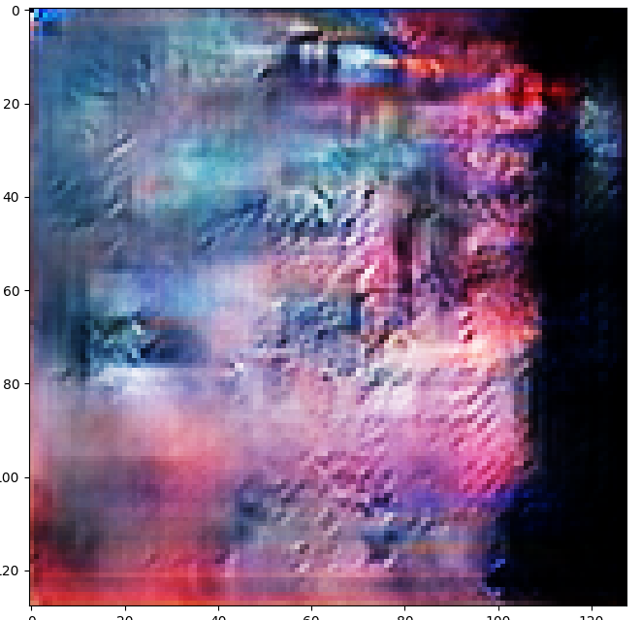
Tests/Demo
EDM examples

Slide 19
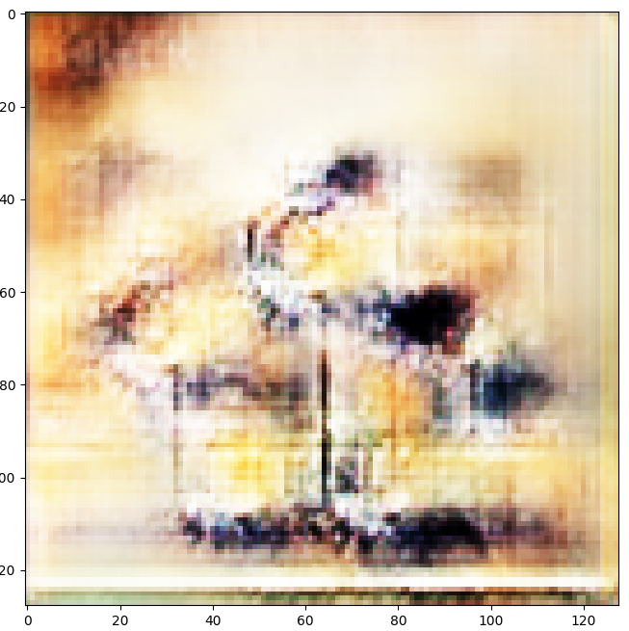
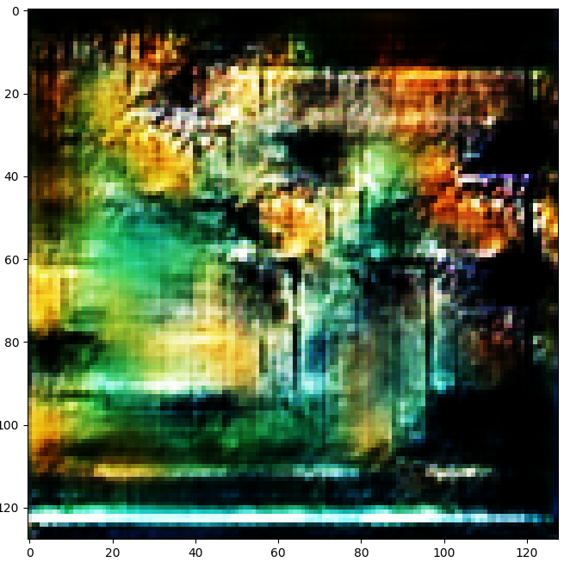
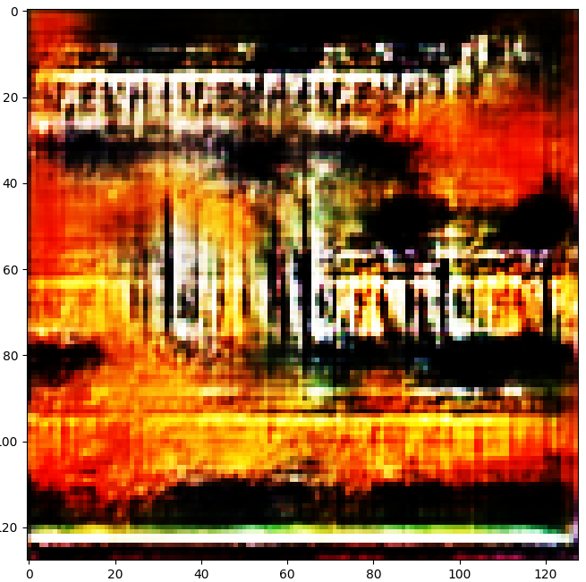
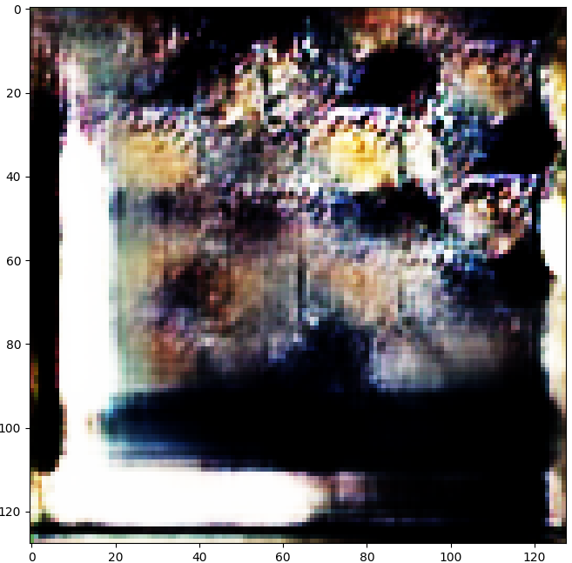
Tests/Demo
Metal examples

Slide 20
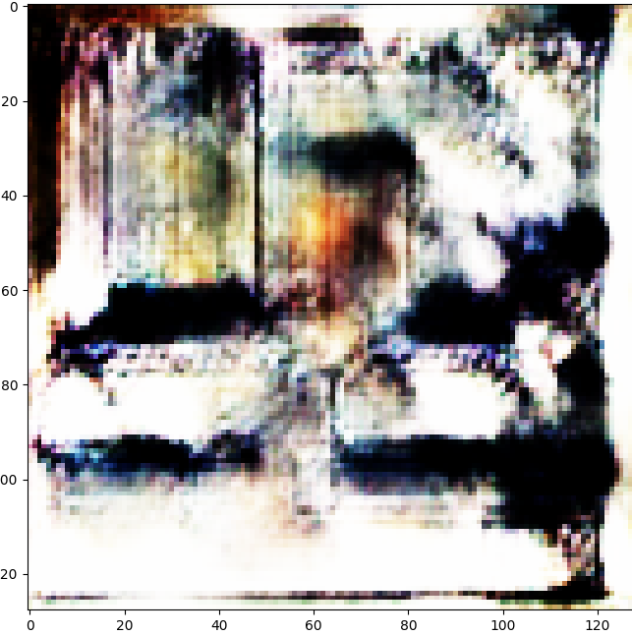
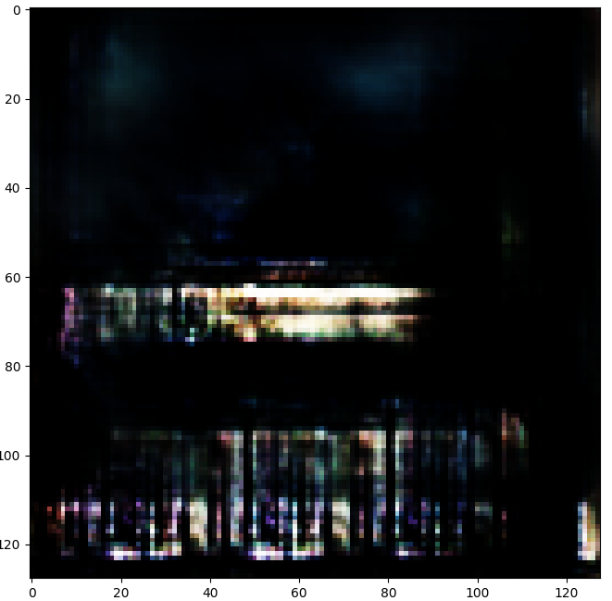
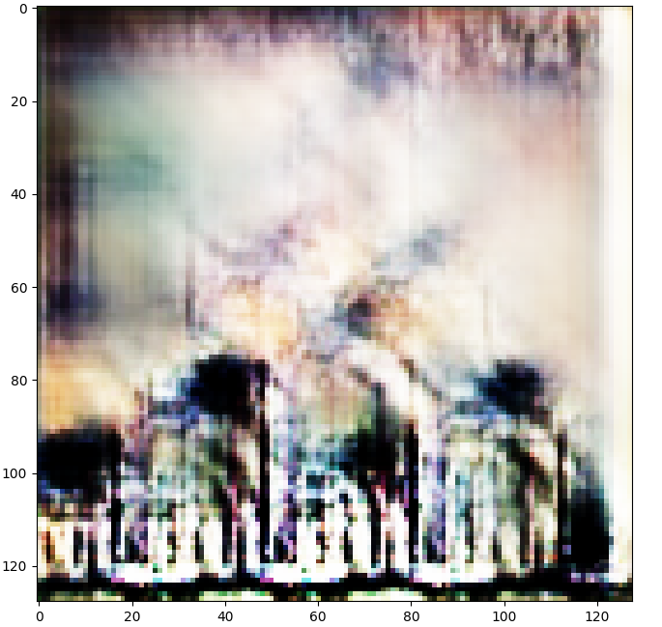
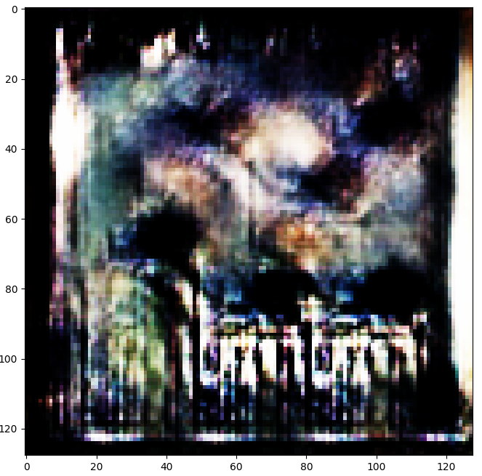
Tests/Demo
General examples

Slide 21
References
Radford, Alec, Luke Metz, and Soumith Chintala. "Unsupervised representation learning with deep convolutional generative adversarial networks." arXiv preprint arXiv:1511.06434 (2015).
https://arxiv.org/pdf/1511.06434.pdf%C3
Shrestha, Anish. “Generating Modern Art Using Generative Adversarial Network(GAN) on Spell.” Medium, Towards Data Science, 3 Feb. 2020, towardsdatascience.com/generating-modern-arts-using-generative-adversarial-network-gan-on-spell-39f67f83c7b4.
Wibowo, Haryo Akbarianto. “Generate Anime Style Face Using DCGAN and Explore Its Latent Feature Representation.” Medium, Towards Data Science, 13 Apr. 2019
towardsdatascience.com/generate-anime-style-face-using-dcgan-and-explore-its-latent-feature-representation-ae0e905f3974.
https://spotipy.readthedocs.io/en/2.12.0/
https://archive.org/details/audio-covers

